Slide 1
CS 419: Production Rendering Path Tracing
Eric Shaffer

Slide 2
A Brief History of Path Tracing
Path tracing ≈ recursive ray-tracing
Turner Whitted [1979]: perfect specular reflection and refraction
Cook et al [1984]: stochastic ray-tracing
glossy effects
motion blur
depth of field
Kajiya [1986]: rendering equation, full global illumination
Lafortune [1993]: Bidirectional path-tracing
Jensen [1995]: Photon mapping

Slide 3
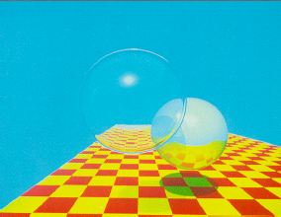
Whitted Ray-Tracing
1979, Turner Whitted
As an aside:
74 minutes at 640x480
8 Moore’s Law CPU doublings in 27 years
12 doublings 74min -> 1 sec
We should now have 1024x1024 at 16 f.p.s.

Slide 4
Whitted Ray-Tracing
Recursive
Three rays are generated at each surface hit
shadow
reflection
refraction
Enables transparency and mirrors
Is not a good approximation for global illumination

Slide 5
Global Illumination
Whitted ray-tracing can’t discover certain light paths
The l1 to l2 path below wouldn’t be discovered

Slide 6
Path Tracing
Path Tracing attempts a more complete approximation of the rendering equation
Each ray is followed in a scene until:
It hits a light
Maximum recursion depth is reached
The ray leaves the scene

Slide 7
Path Tracing
At each hit point, a PDF is determines reflected ray direction
In pure Path Tracing radiance only comes from area lights
no point or directional lighting
A primary ray and its reflected rays are a ray path
Typically shoot multiple rays per pixel

Slide 8
Path Tracing
Bottom surface is Lambertian
Wall is specular
Cyan primary ray represents multiple primary rays

Slide 9
Path Tracing
Material type determines ray orientation
Pure Lambertian surfaces reflect rays in a random direction
Relying only on hitting lights leads to long convergence times
Few paths will hit lights in the recursion depth limit

Slide 10
A Monte Carlo Estimator for Path Tracing
To evaluate the radiance at each pixel:
Note: subscript i refers to incoming irradiance…not an index

Slide 11

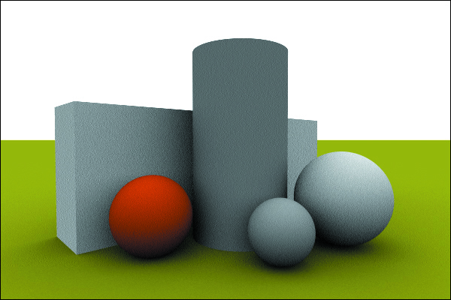
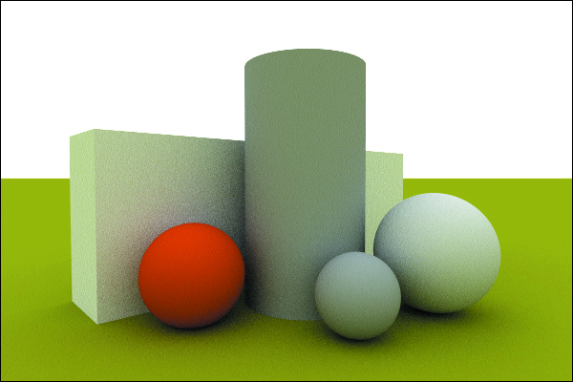
Path Tracing with an Environment Light
Zero bounces…one bounce….five bounces

Slide 12
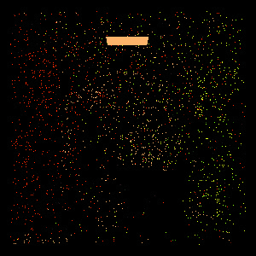
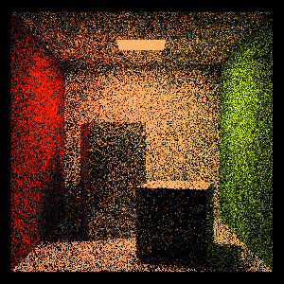
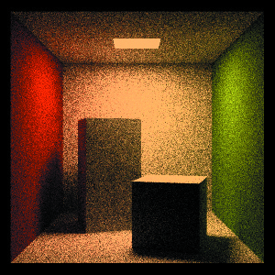
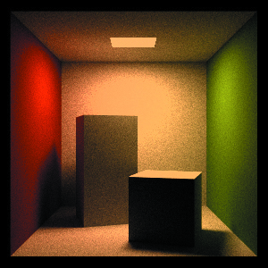
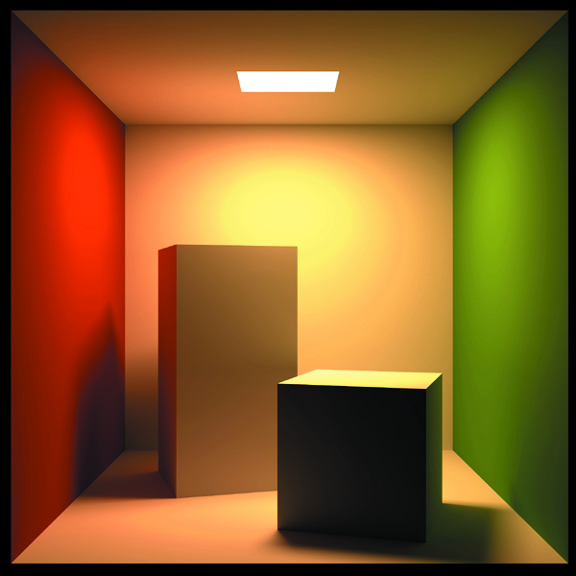
Path Tracing with an Area Light
1 sample per pixel 100 1024 10,000
100,000

Slide 13
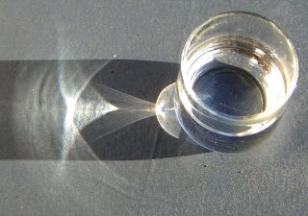
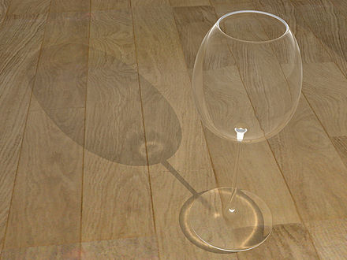
Caustics
Created by curved reflectors
Concentrate the reflected light
Caustics become thinner and sharper as light source becomes smaller or distant
Photon Mapping allows point/directional lights to generate caustics

Slide 14
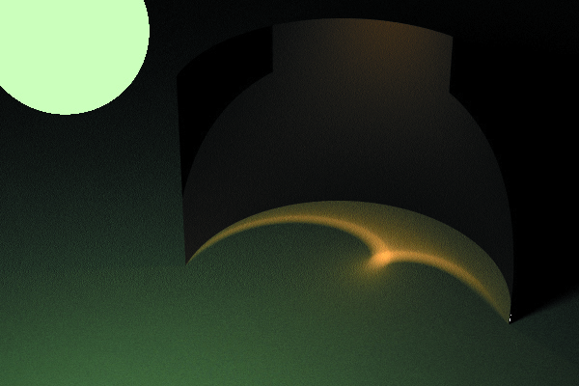
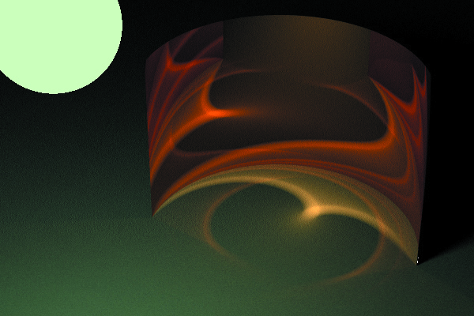
More Caustics
Recursion depth 2 versus 5

Slide 15
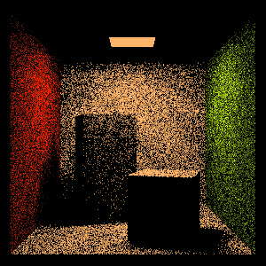
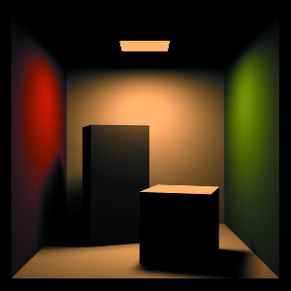
Speedup through Light Sampling
Can employ a hybrid approach
Direct illumination computed by sampling lights
Indirect illumination computed by path tracing
Must take care not to render direct illumination twice
Sample direct illumination with a shadow ray
Indirect illumination as before
Hit on a light returns radiance if ray depth ≠ 1

Slide 16
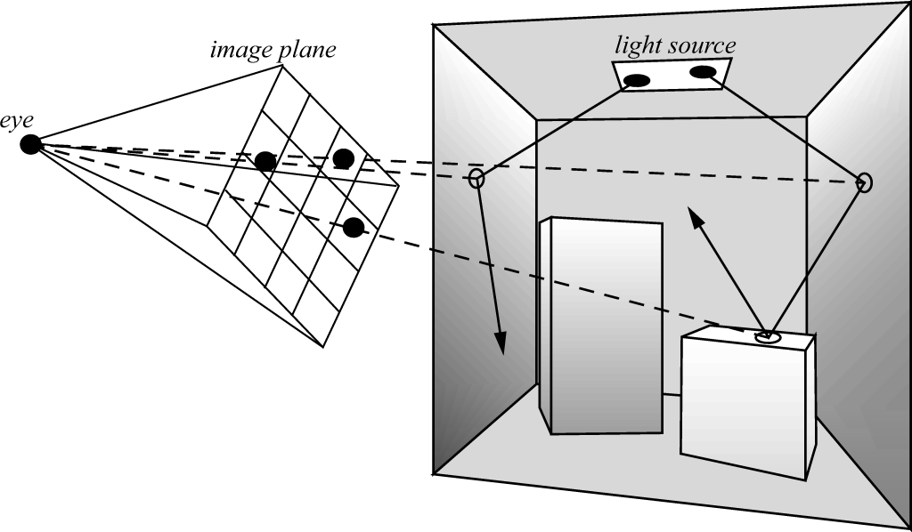
Bidirectional Path Tracing
Rays are traced from the lights and from the cameras
Endpoints and midpoints of paths are linked up to estimate radiance

Slide 17
Bidirectional Path Tracing
Lafortune & Willems, Compugraphics ’93, Veach & Guibas, EGRW 94
Send paths from light source, record path vertices
Send paths from eye, record path vertices
Use shadow rays to connect every vertex of eye path with every vertex in light path
Creates abundance of paths from light to eye
Need weighted average of these path results

Slide 18
Metropolis Light Transport
Based on Metropolis et al., Equation of State Calculations by Fast Compting Machines, J. Chemical Physics 21(6), 1953, pp. 1087-1092.
Adapted to bidirectional path tracing by Veach & Guibas, S97
Start with a connected path of light from the light source to the eye
Perturb the path of light to find new paths

Slide 19
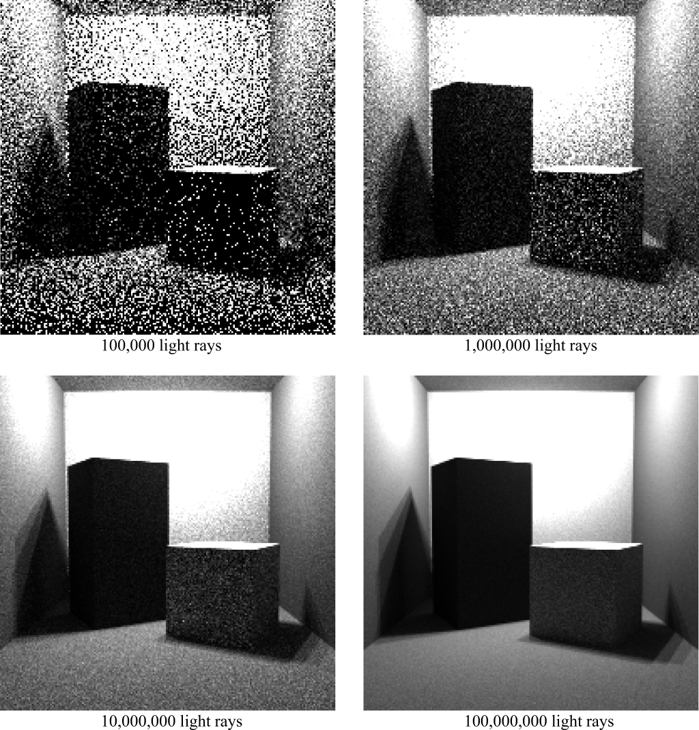
Pure Light Tracing Algorithm
For each pixel, we evaluate a measurement equation
Generate sample points and directions on lights
Importance of those samples to the pixel evaluated, leading to a radiance estimate

Slide 20
Russian Roulette
Recursive path generator needs a stopping condition
What is wrong with a simple depth limit?
When a ray hits a light
Radiance needs to be multiplied by what factors from previous intersection points?
Suppose we store this factor along a path…what cutoff criterion is suggested by that possibility?

Slide 21
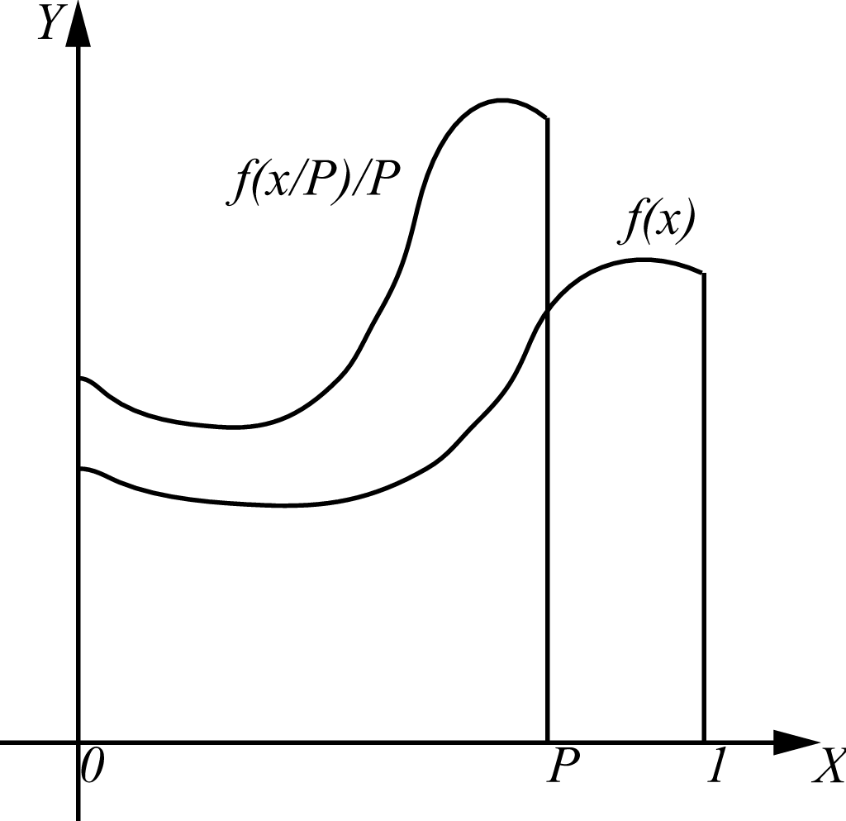
Russian Roulette
Imagine evaluating I as follows:
if f(x) is recursive, what is the probability the recursion stops at each evaluation point?

Slide 22
Russian Roulette and Bias
A biased algorithm changes the expected value of the Monte Carlo estimator so that it no longer matches the value of the integral.
Is RR biased? Look at the previous picture….
What is the benefit of a high absorption factor?
What is the drawback?
Imagine we set P to the reflectance of a surface. What surfaces absorb the path with greater frequency?

Slide 23
Pure Path Tracing: the Good
Path tracing concentrates on important paths only
Those that hit the eye
Those from bright emitters/reflectors
General surfaces – only requires ray intersections
Unbiased estimates – at any point, the expected value is correct (although variance might be high)

Slide 24
Pure Path Tracing: the Bad
It treats every pixel independently, and every point on every surface independently
Good for specularities, which vary quickly over surfaces
Bad for diffuse illumination, which varies very slowly over surfaces (except at sharp shadow boundaries)
Effort is wasted getting good estimates for
Direct illumination, which is responsible for the most obvious illumination discontinuities (edges)
Diffuse illumination, which varies slowly over a surface

Slide 25
Path Re-Use
Consider a diffuse surface for which we want an outgoing radiance estimate
Typically, we would cast more rays to get it, but what if we already know what happened at a nearby spot?

Slide 26
Diffuse Dependency
Diffuse reflectance depends only on the irradiance at the surface point
The total amount of light arriving – incoming direction is irrelevant
This tends to vary slowly over a surface
Directional light gives constant irradiance over a planar surface
Point light varies only with the cosine of the angle – slowly

Slide 27
Basic Idea
Store information about previous paths
When the irradiance at a point is required, construct irradiance estimates from the stored data
The sub-problems are:
How do you get the samples in the first place?
How to you store them?
How do you construct the estimate?

Slide 28
Irradiance Caching
Start with a basic path tracing algorithm, but …
Maintain a spatial data structure storing examples of irradiance arriving at points
If you hit a diffuse surface, try to build an estimate of irradiance at that point
If the estimate is good, use it
If not, use path tracing to estimate the irradiance and store it
Some questions:
How do we store the samples?
How do we decide whether to compute a new value?

Slide 29
Storing Samples
It doesn’t much matter how you store the samples
Data structure must support insertion of new samples, and search for nearby samples, indexed on position
The RADIANCE system is an implementation of Irradiance Caching, and it uses Octrees
Question of precisely what to store:
Irradiance
The location
The normal at that location

Slide 30
Quality of Existing Data
The quality of an estimate is based on geometric considerations
Examine:
Surface curvature between the required point and the existing data
diffuse illumination changes with curvature
Brightness and the distance to other surfaces
Influences how fast incoming illumination can change
Assume extreme variation in incoming radiance
If existing values are used, weigh contribution by quality

Slide 31
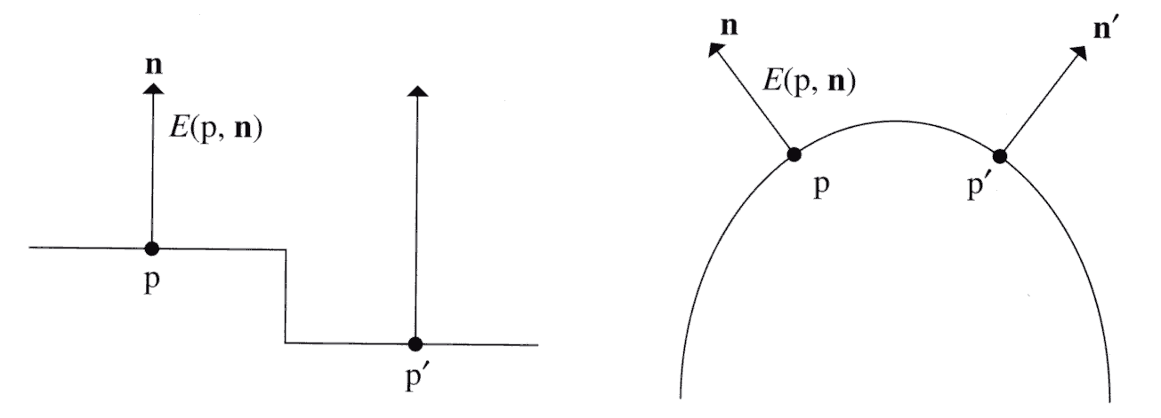
Geometric Factors
Small distance, but maybe big change in irradiance
Points and normals should be close
Distance to nearby surfaces should be large – corners lead to fast changes in irradiance

Slide 32
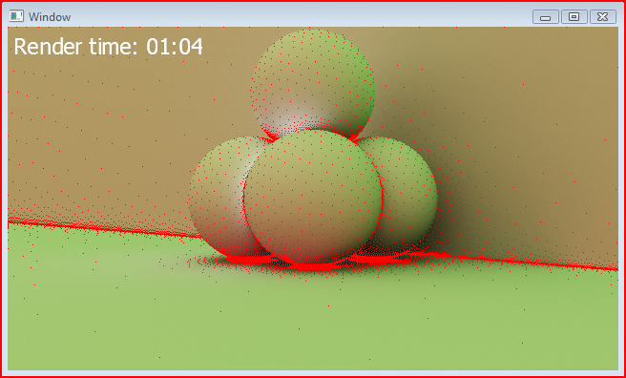
Locations of Estimates

Slide 33
Implementation Notes
In a full system, choices must be made as to what constitutes a diffuse surface
PBRT assumes anything that isn’t specular
Error goes up as reflectance varies further from diffuse
Also have to make sure that direct lighting is not double counted
Must account for transmission and reflection
Separate irradiance estimates for both sides of a surface

Slide 34
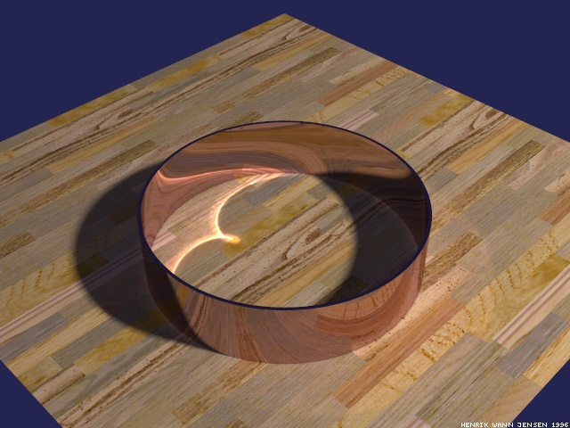
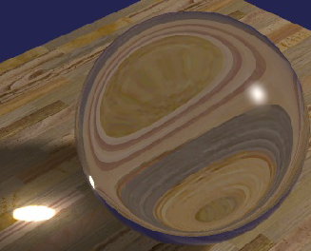
Refraction of a Caustic
Monte-Carlo ray tracing handles all paths of light: L(D|S)*E, but not equally well
Has difficulty sampling LS*DS*E paths, e.g. refraction of a caustic
Path tracing would need a very lucky first hit
Bidirectional ray tracing can find caustic, but reflection of caustic still needs lucky first hit during path tracing
Metropolis light transport can find a caustic path, but would need lucky perturbation to find its reflection

Slide 35
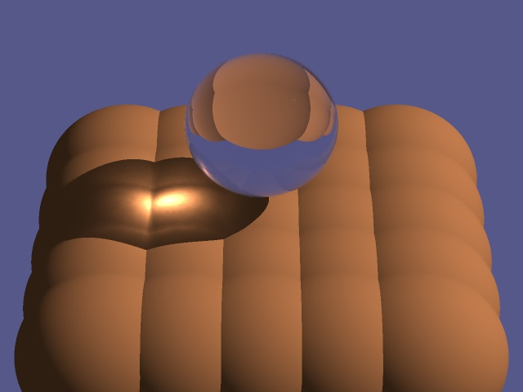
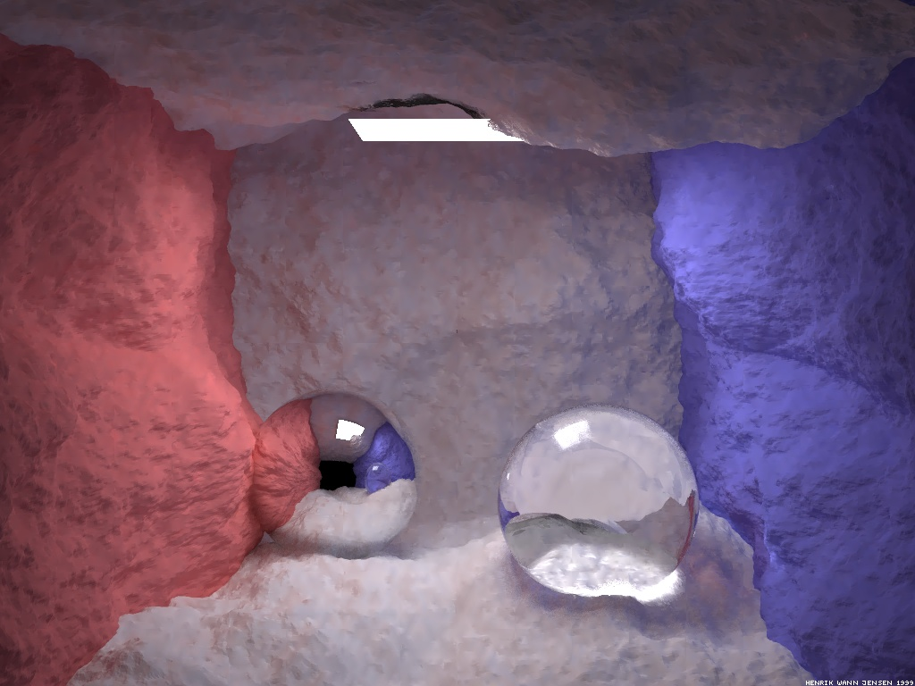
Photon Mapping
Jensen EGRW 95, 96
Simulates the transport of individual photons
Photons emitted from light sources
Photons bounce off of specular surfaces
Photons deposited on diffuse surfaces
Held in a 3-D spatial data structure
Surfaces need not be parameterized
Photons collected by path tracing from eye

Slide 36
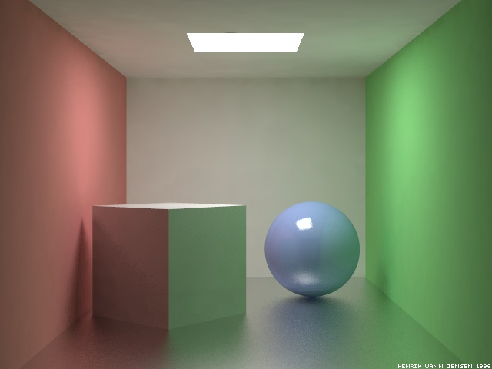
Why Map Photons?
High variance in Monte-Carlo renderings results in noise
Collection of deposited photons into a “photon map” (a 3-D spatial data structure) provides a flux density estimate
Flux samples filtered easier than path samples, resulting in error at lower frequencies
Error is a result of bias, which decreases as the number of samples increase
And, oh yeah, it’s a lot faster
The scene above contains glossy surfaces, and was rendered in 50 minutes using photon mapping. The same scene took 6 hours for render with Radiance, a rendering system that used radiosity for diffuse reflection and path tracing for glossy reflection.

Slide 37
What is a Photon?
A photon p is a particle of light that carries flux ΔΦ_{p}(x_{p}, ω_{p})
Power: ΔΦ_{p} – magnitude (in Watts) and color of the flux it carries, stored as an RGB triple
Position: x_{p} – location of the photon
Direction: ω_{p} – the incident direction ω_{i} used to compute irradiance
Photons vs. rays
Photons propogate flux
Rays gather radiance
ω_{p}
ΔΦ_{p}
x_{p}

Slide 38
Sources
Point source
Photons emitted uniformly in all directions
Power of source (W) distributed evenly among photons
Flux of each photon equal to source power divided by total # of photons
For example, a 60W light bulb would send out a total of 100K photons, each carrying a flux ΔΦ of 0.6 mW
Photons sent out once per simulation, not continuously as in radiosity

Slide 39
Russian Roulette
Arvo & Kirk, S90
Reflected flux only a fraction of incident flux
After several reflections, spending a lot of time keeping track of very little flux
Instead, completely absorb some photons and completely reflect others at full power
Spend time tracing fewer full power photons
Probability of reflectance is the reflectance ρ.
Probability of absorption is 1 – ρ.
?
ρ = 60%

Slide 40
Mixed Surfaces
Surfaces have specular and diffuse components
ρ_{d} – diffuse reflectance
ρ_{s} – specular reflectance
ρ_{d} + ρ_{s} < 1 (conservation of energy)
Let ζ be a uniform random value from 0 to 1
If ζ < ρ_{d} then reflect diffuse
Else if ζ < ρ_{d} + ρ_{s} then reflect specular
Otherwise absorb
ρ_{d} = 50%
ρ_{s} = 30%

Slide 41
Storing Photons
Uses a kd-tree – a sequence of axis-aligned partitions
2-D partitions are lines
3-D partitions are planes
Axis of partitions alternates wrt depth of the tree
Average access time is O(log n)
Worst case O(n) when tree is severely lopsided
Need to maintain a balanced tree, which can be done in O(n log n)
Can find k nearest neighbors in O(k + log n) time using a heap

Slide 42
Reflected Radiance
Recall the reflected radiance equation
Convert incident radiance into incident flux
Reflected radiance in terms of incident flux
Numerically
ΔA = πr²

Slide 43
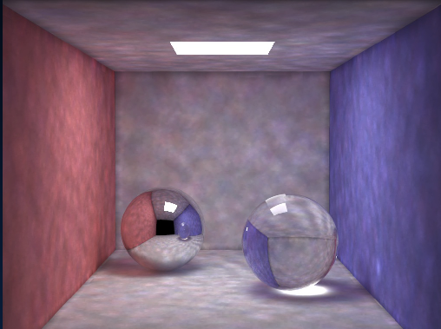
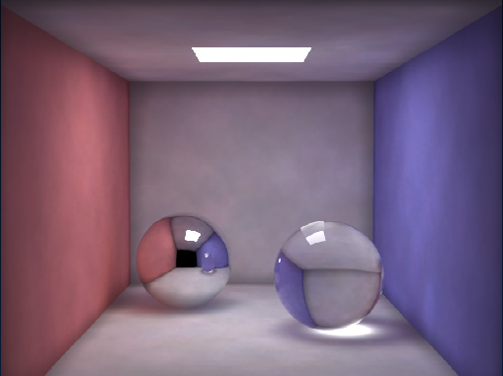
How Many Photons?
How big is the disk radius r?
Large enough that the disk surrounds the n nearest photons.
The number of photons used for a radiance estimate n is usually between 50 and 500.
Radiance estimate using 50 photons
Radiance estimate using 500 photons
ΔA = πr²

Slide 44
Filtering
Too few photons cause blurry results
Simple averaging produces a box filtering of photons
Photons nearer to the sample should be weighted more heavily
Results in a cone filtering of photons

Slide 45
Multiple Photon Maps
Global L(S|D)*D photon map
Photon sticks to diffuse surface and bounces to next surface (if it survives Russian roulette)
Photons don’t stick to specular surfaces
Caustic LSS*D photon map
High resolution
Light source usually emits photons only in directions that hit the thing creating the caustic
Caustic map photons
Global map photons

Slide 46
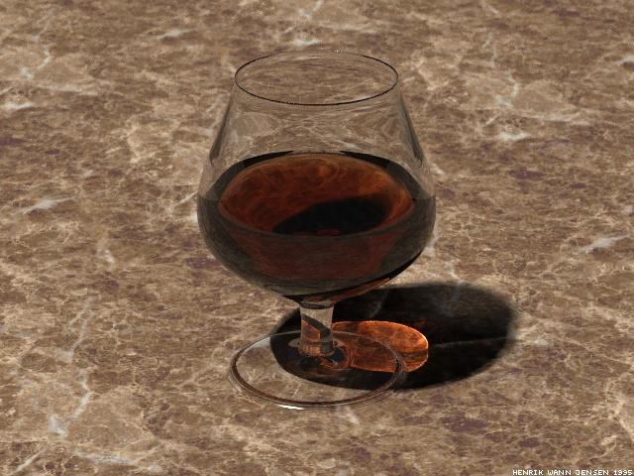
Rendering
Rendered by glossy-surface distributed ray tracing
When ray hits first diffuse surface…
Compute reflected radiance of caustic map photons
Ignore global map photons
Importance sample BRDF f_{r} as usual
Use global photon map to importance sample incident radiance function L_{i}
Evaluate reflectance integral by casting rays and accumulating radiances from global photon map
Use global map photons to return radiance when evaluating Li at first diffuse intersection.
First diffuse intersection. Return radiance of caustic map photons here, but ignore global map photons

Slide 47
Exam Topics
Radiometry
Rendering Equation
BRDFs
Monte Carlo Methods
Spatial Data Structures
Grids
KD-Trees
BVHs
Path Tracing

Slide 48
Monte Carlo Estimator
Suppose we wish to compute the volume of intersection between a sphere of radius 1 centered at the origin and the plane y=0.25
We can generate uniformly distributed random numbers in the interval [0,1]
Define a monte carlo estimator for computing this integral

Slide 49
Path Tracing
What recursion depth is necessary to have any hope of capturing color-bleeding (surface-surface inter-refection)?
In addition to path tracing, suppose we shoot shadow rays to directly sample lights. Do we need to make any other adjustment to the algorithm?

Slide 50
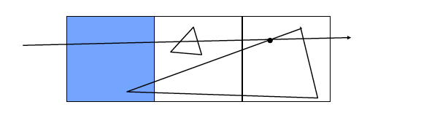
Grids
Suppose we have a 3 x 3 uniform grid
corners (0,0,0) and (30,30,30)
Imagine a point (maybe the source of a ray) at (5.0, 15.5, 21.2)
What is the Morton code for that point?
What problem is illustrated with the ray instersection pictured below? How is it resolved?

